Slide 1
美食华章
GROUP 6

Slide 2
General Introduction
01

Slide 3
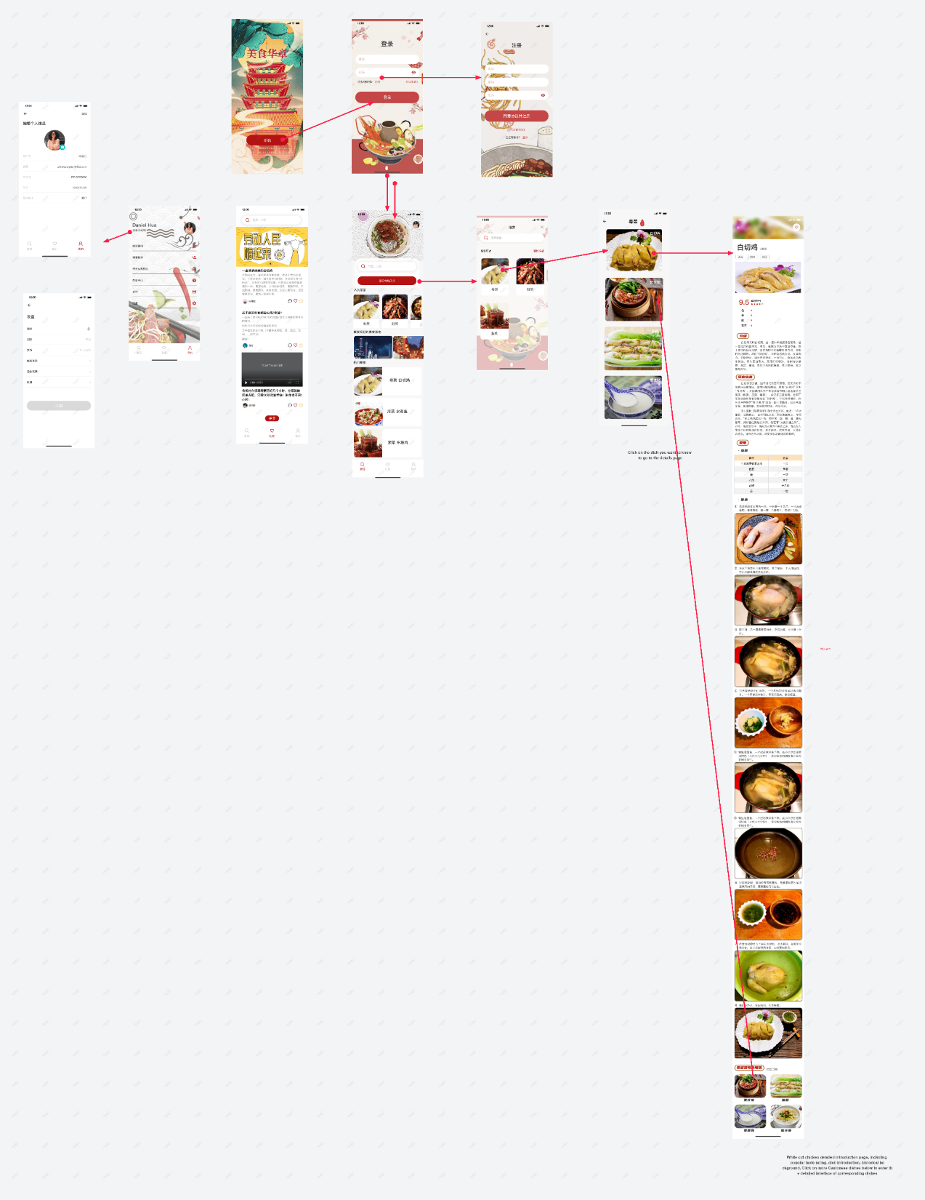
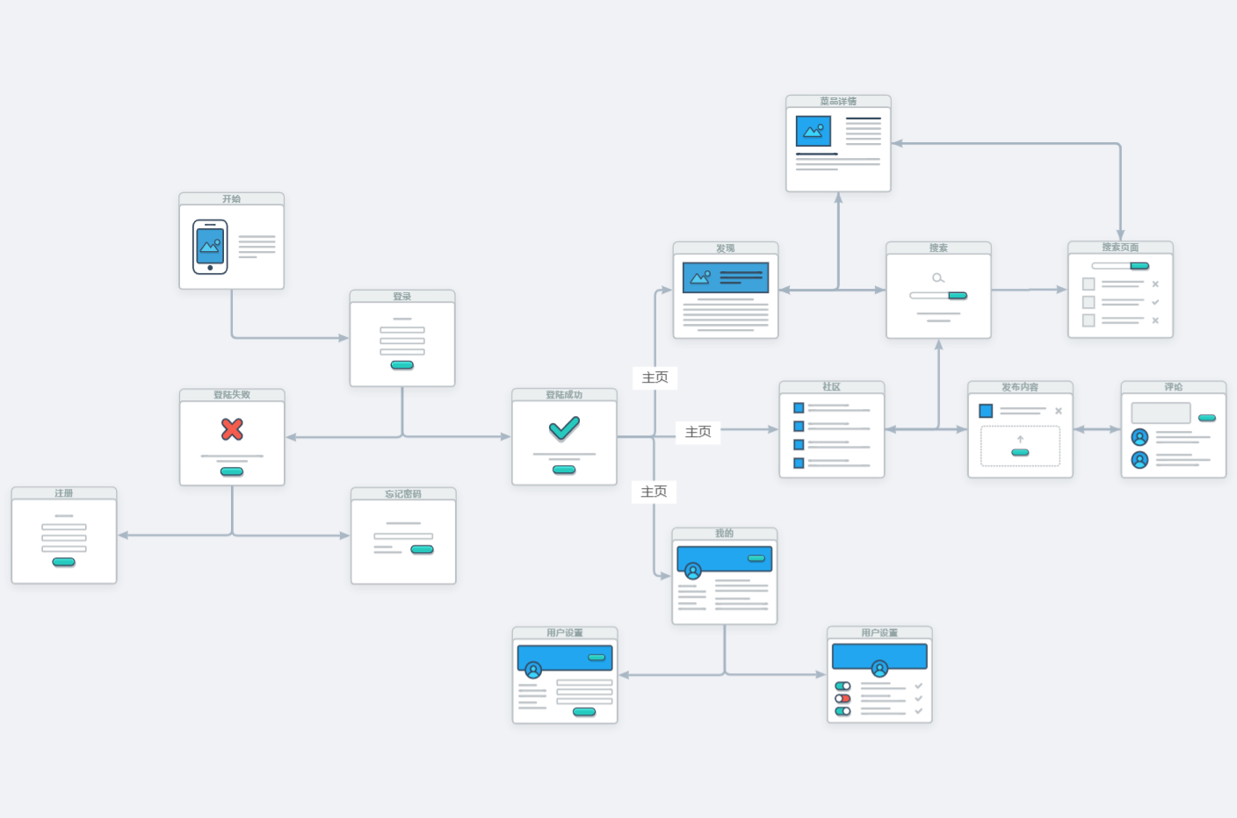
User Screen Flows

Slide 4
Page Introduction
02

Slide 5
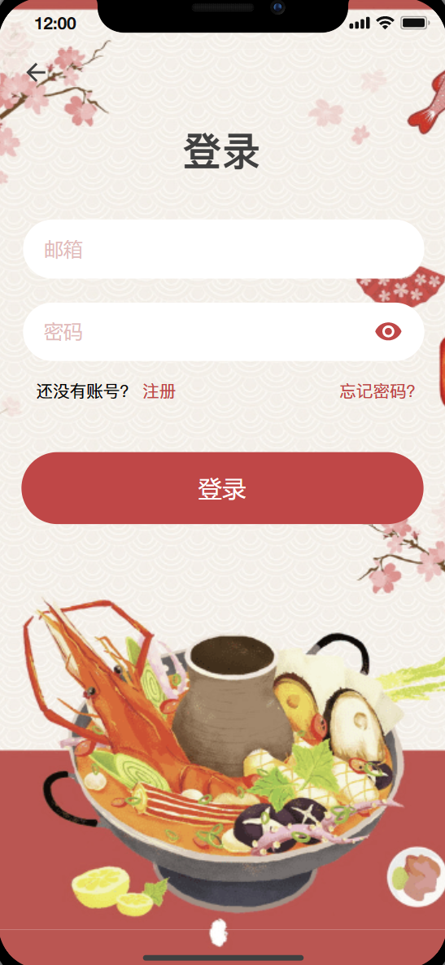
Login/registration page
Login
Entering the wrong user password will result in an error message
Register
Animations
There is a right swipe animation from the landing page to the registration page; There is a sliding down animation from the login page to the home page.
Notes:
e922e919-1249-43c4-a883-c46710756075.source.default.zh-Hans

Slide 6
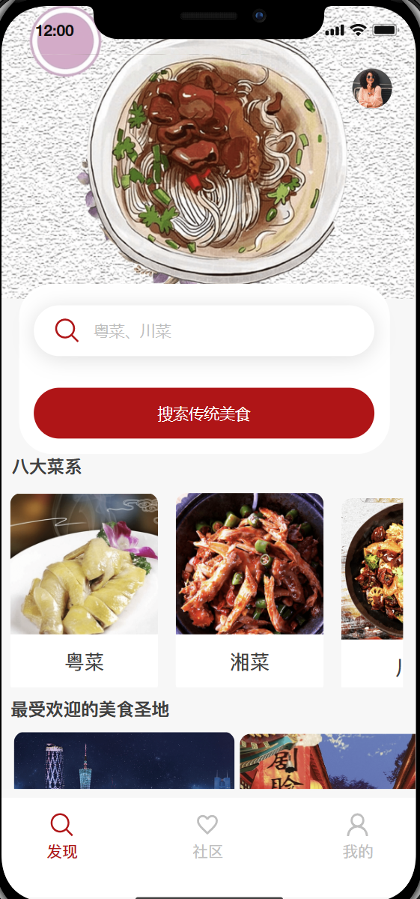
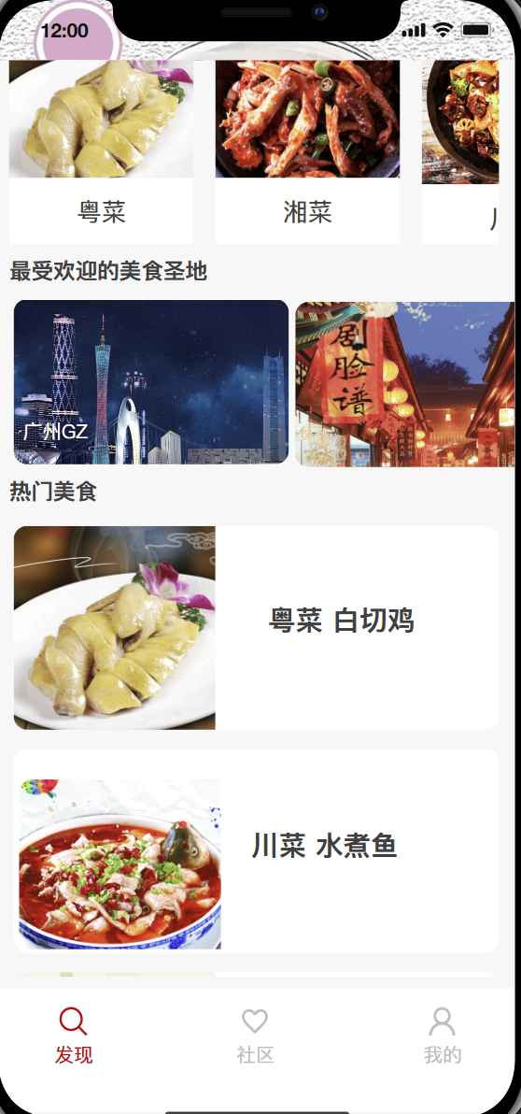
Home page
Search
Food mecca
Click the search box, and after the jump animation, it will jump to the search page
Under development...
List of eight major cuisines
Hot food
Clicking on each cuisine will take you to a list of corresponding cuisines
Click to go to the hot food related introduction

Slide 7
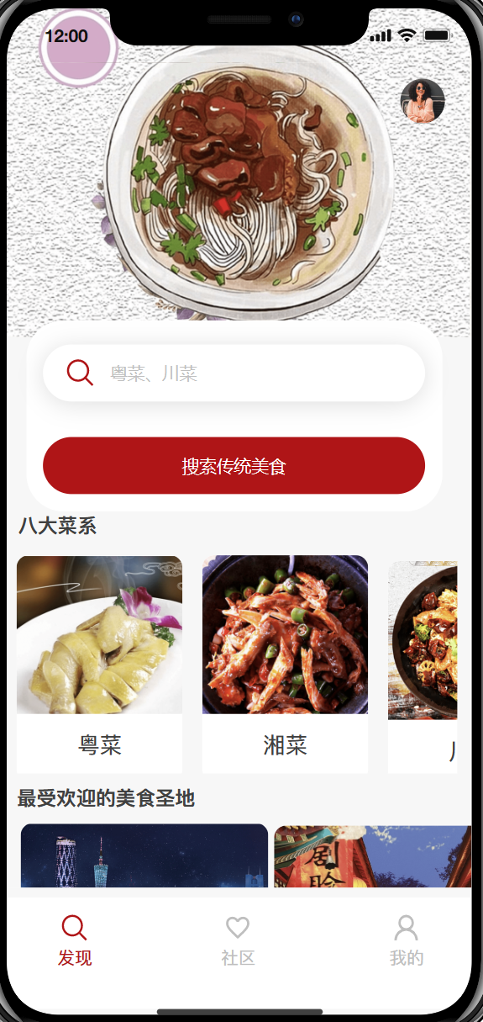
List of eight major cuisines
Function
Effect of wheel casting
Click to jump to a list of different cuisines
Slide horizontally to display local delicacies

Slide 8
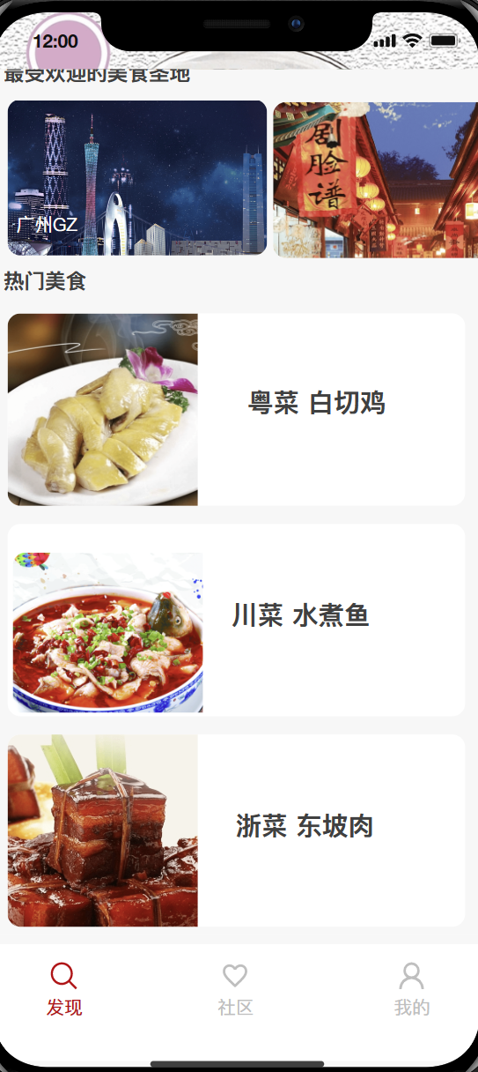
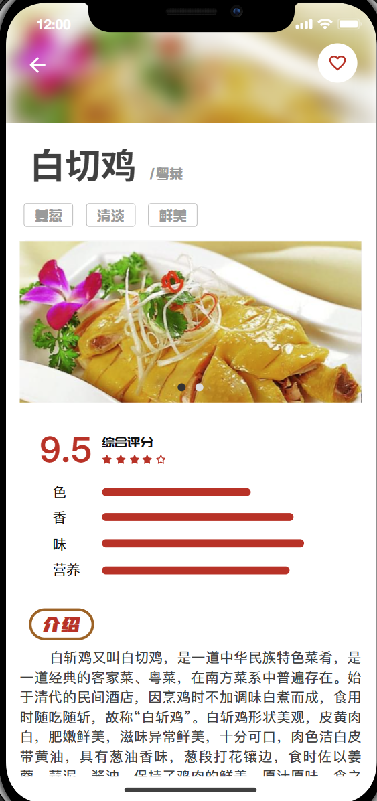
Hot food

Slide 9
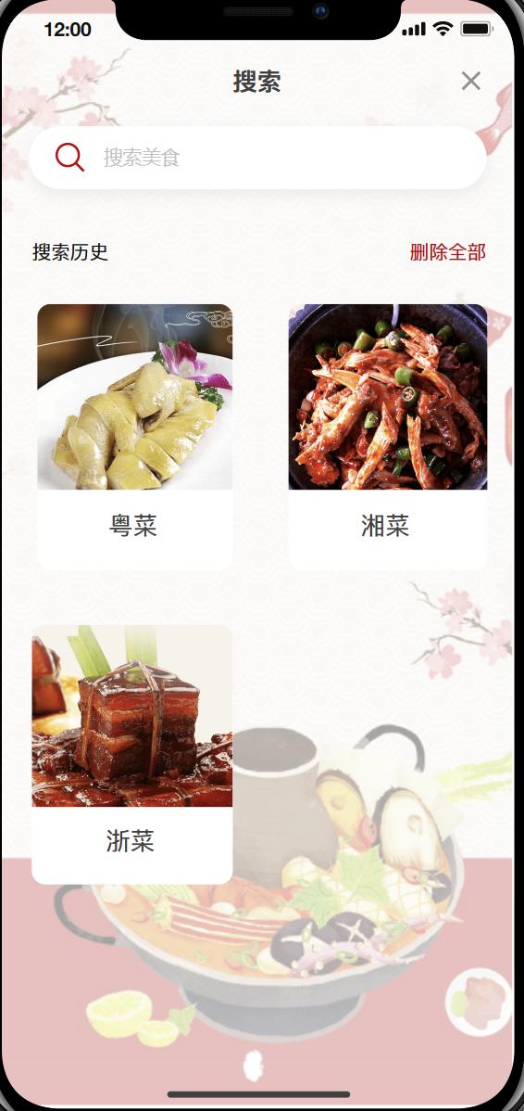
Search page
Search function
Users can search for the food they are interested in by entering the food keyword
Record history Search record function
It has a record function for users to search the food, convenient for users to find in time
Animations
Has sliding animation down and up
Notes:
e922e919-1249-43c4-a883-c46710756075.source.default.zh-Hans

Slide 10
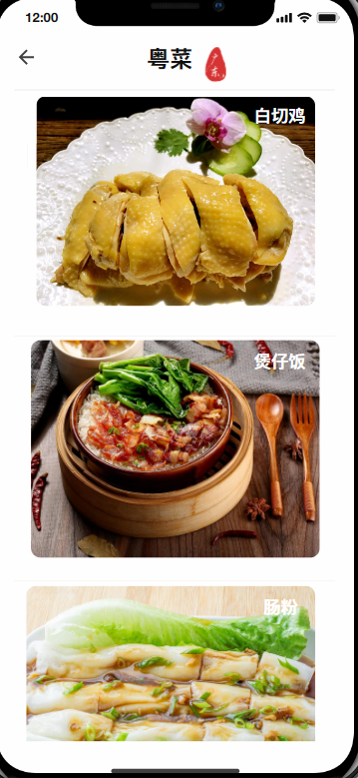
Cantonese cuisine list
Function
Click to jump to the menu details interface
Animations
The page switches with animations that slide from right to left
Zoom in when the mouse moves over the dish card
Notes:
e922e919-1249-43c4-a883-c46710756075.source.default.zh-Hans

Slide 11
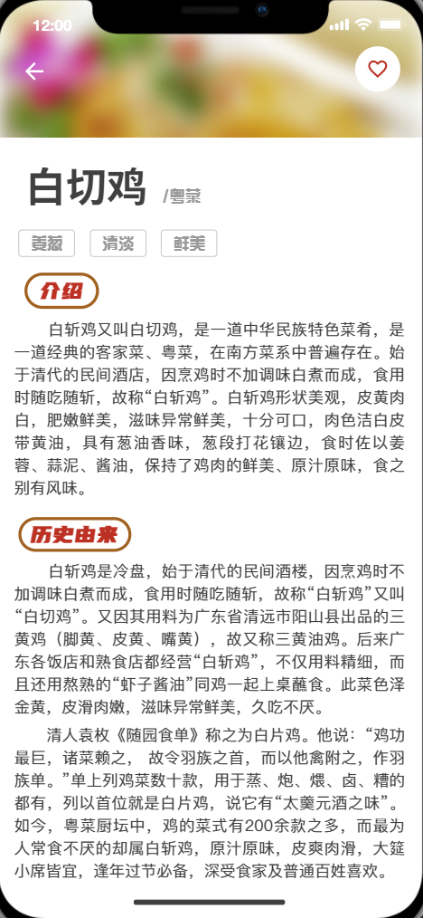
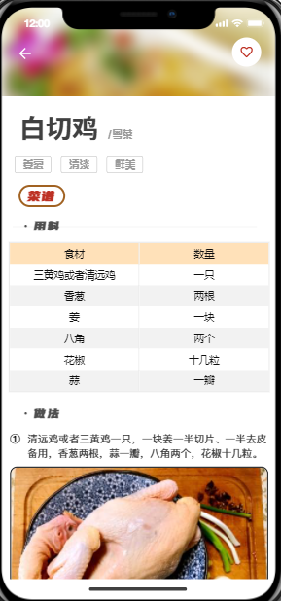
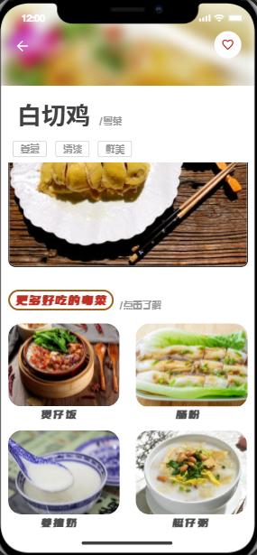
Menu details interface
Food label, score strip rotograph
Introduction column History column
Recipe (Ingredients + preparation)
More Cantonese food recommendations

Slide 12
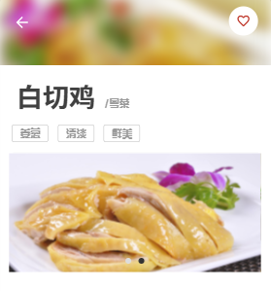
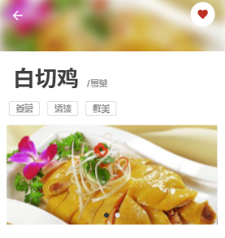

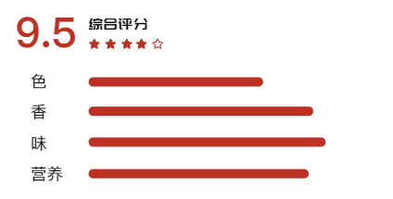
Implemented animation
Click Hollow to solid
The score bar extends gradually

Slide 13
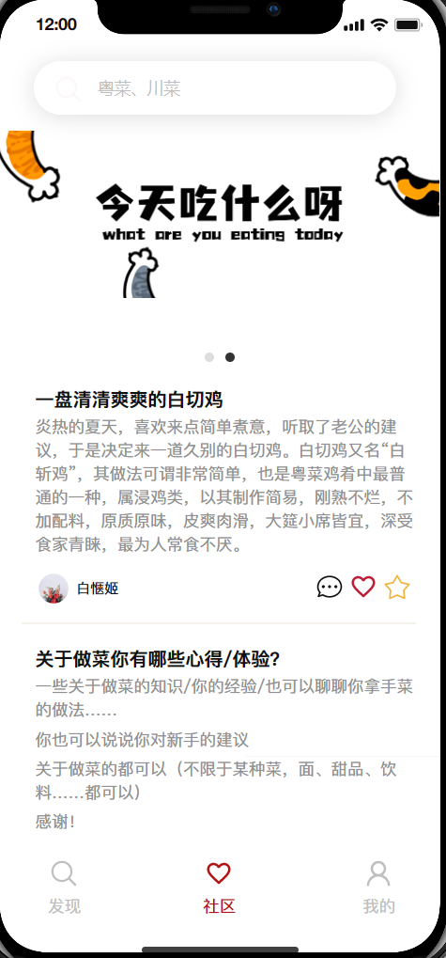
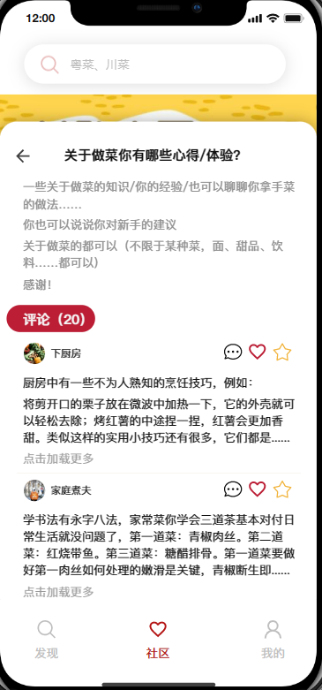
Community page
Search
Comment
Click the search box, and after the jump animation, it will jump to the search page
Click comment to go to the details page
Like
Animations
Click on the Hearts and stars to like or bookmark the post
Like hearts throbbing, favorite stars wiggling, comments popping up

Slide 14
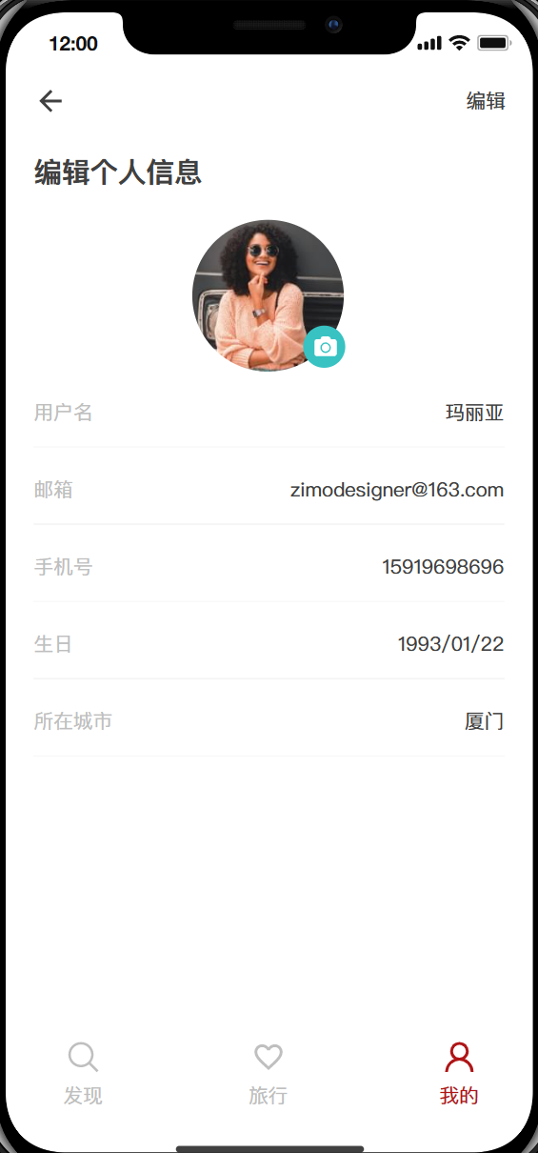
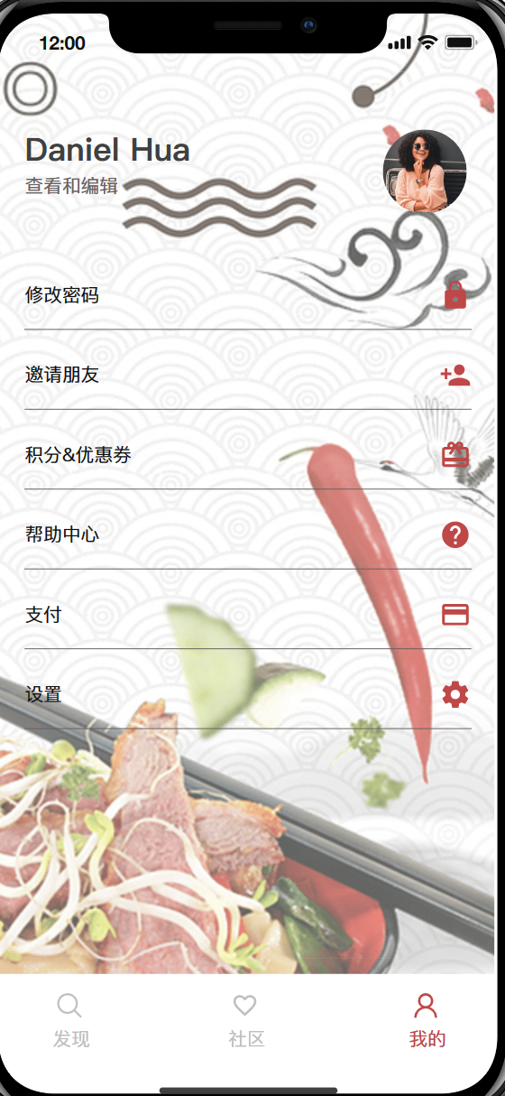
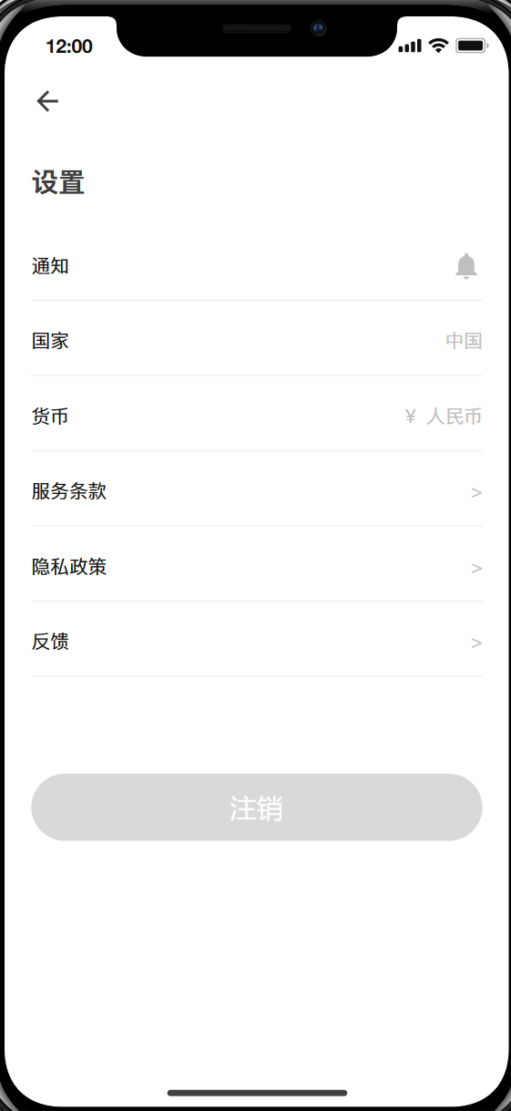
In my page, you can click the profile picture or name to jump to the personal information page and edit your personal information.
You can adjust the app by clicking Settings.
Personal page

Slide 15
Effect display
03

Slide 16
Thank you!

